Slide 1
EVALUATION OF REACTIVITY OF POLLUTANTS ON SURFACES (PHOTOCATALYTIC COATINGS)
FLAT DENUDER
CRS046/004/06 - TRAINING (LAB & OVM PROJECT) – 01-21/10/2006
Notes:
1

Slide 2
Objectives
To develope a new experimental set-up in order to investigate, identify and quantify, in a controlled and reliable way, the photocatalytic decomposition of NO₂ using TiO₂ coatings;
to determine the relationship between the photocatalytic reactivity of TiO₂ coatings and reaction conditions (temperature, humidity, gas flow rate, light intensity, pollutant concentration) over range of typical environmental conditions;
to investigate and to identify the chemical mechanisms of the photocatalytic reaction of TiO₂ coatings in the presence of simulated sunlight.
to determine the reaction efficiency and the reaction products of the photocatalytic decomposition.

Slide 3
TITANIUM DIOXIDE
NO + O₂⁻ → NO₂ + NO₃⁻
hν
Energy
NO₂ + OH. → NO₃⁻
O₂⁻
Conduction Band
O₂
3,2 eV
OH.
Valence Band
e⁻
h⁺
OH⁻_{(ads)} e H₂O _{(ads)}
Notes:
3

Slide 4
TITANIUM DIOXIDE
NO₃⁻
+
O₂
hv(‹ 400nm)
NO₂
e⁻
TiO₂
h⁺
H₂O
OH⁻
O₂⁻
H⁺
HO₂•
OH•
NO₂
NO
NO₂ + OH • NO₃⁻
NO
Notes:
4

Slide 5
EXPERIMENTAL APPARATUS
Permeation tube for NO₂
CARBON DENUDER
ARIA
OUT
Nitrogen
cylinder
HUMICON
Thermostatic
bath
MFC
UV LAMP
COIL
Air
cylinder
NOX
ANALYZER
Na₂CO₃
DENUDER
FLAT DENUDER
Notes:
5

Slide 6
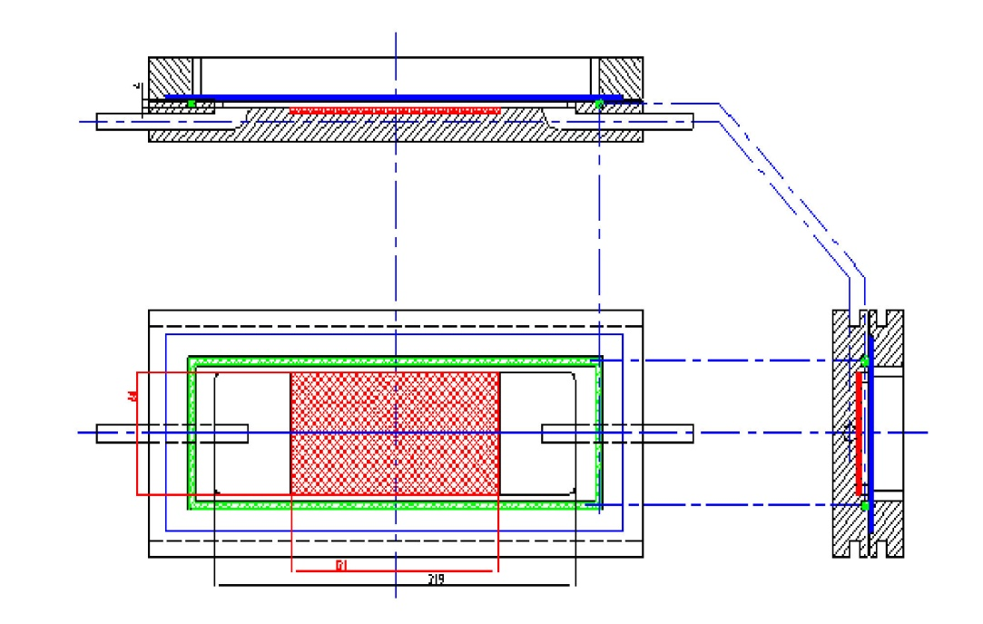
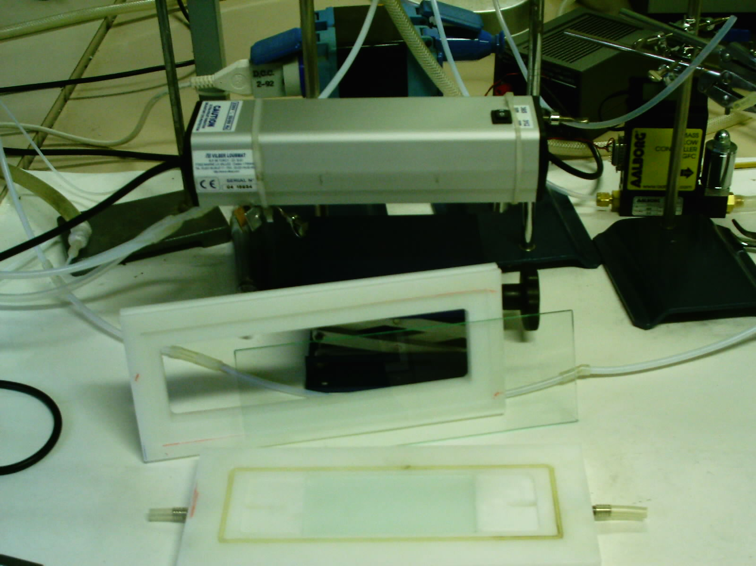
FLAT DENUDER
Gas moves inside the channel, which has a rectangular section
Notes:
6

Slide 7
FLAT DENUDER
Principle
The mass transfer is limited by the diffusion process, perfect sink ( V_{d}→ ∞), Gormley-Kennedy equation for penetration efficiency :
The mass transfer is limited by the surface reactivity (K → 0), non perfect sink, low reactivity;
Notes:
7

Slide 8
Results
Alkaline carbon coated denuder (perfect sink for NO₂)
Denuder in
Notes:
8

Slide 9
Results
Notes:
9

Slide 10
Results
Example of commercial material containing titanium dioxide
Notes:
10

Slide 11
Results
Example of commercial material containing titanium dioxide
Notes:
11

Slide 12
Results
Example of commercial material containing titanium dioxide
Notes:
12

Slide 13
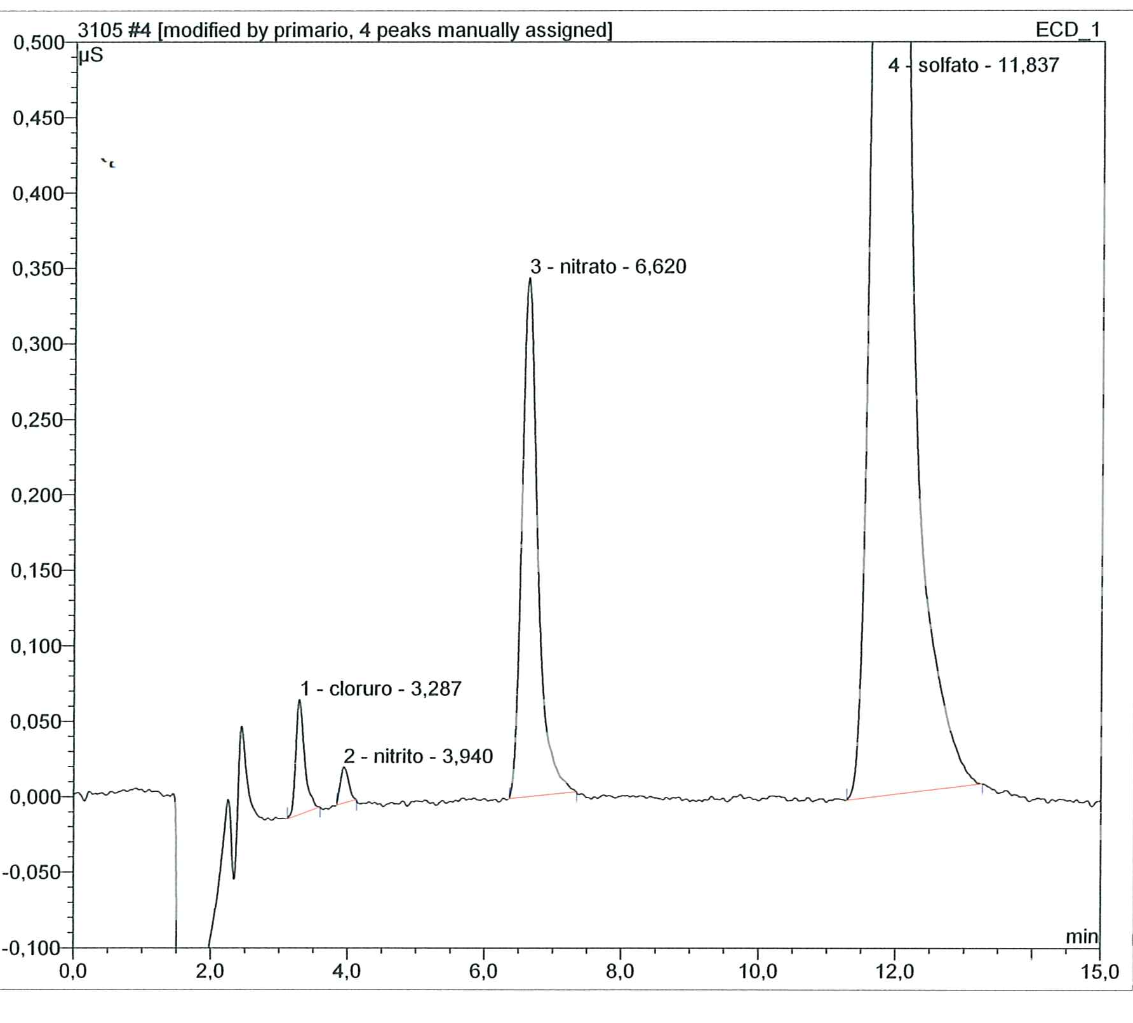
Mass Balance of N species adsorbed on the surface during the experiment
NO₃⁻ from the analysis (mg/m³) | NO₂ ads converted in NO₃⁻ (mg/m³)
1595,6 | 1494,5
Notes:
13

Slide 14
Surface reactivity of pollutants
Deposition velocity
where
Notes:
14

Slide 15
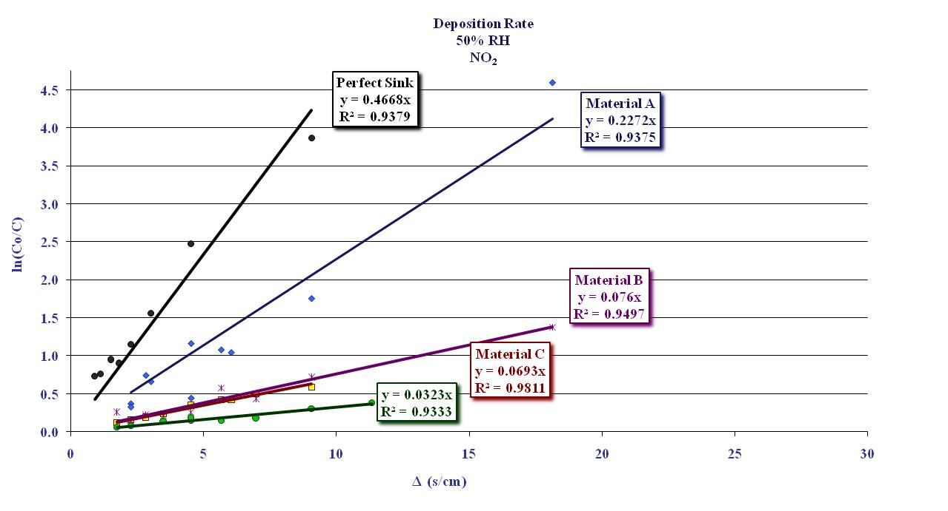
Surface reactivity of pollutants
Deposition velocity
Notes:
15

Slide 16
Surface reactivity of pollutants
Deposition velocity
V_{d} for NO₂(cm/s)
MATERIAL | 20%RH | 50%RH | 80%RH
TEORICO (carbon) | 0,4668 | 0,4668 | 0,4668
MATERIALE A | 0,2514 | 0,2272 | 0,1997
MATERIALE B | 0,1855 | 0,0693 | 0,0173
MATERIALE C | 0,1513 | 0,0760 | 0,0050
Notes:
16

