Slide 1




ENVINT
FOR A CLEANER AIR WORLDWIDE
A New Device for Automatic Sampling of Passive Samplers and Monitoring Air Pollutants
Ivo ALLEGRINI
ENVINT srl ,Montopoli S. (RI), Italy

Slide 2
Air Pollution Monitoring by Passive Samplers
Passive sampler includes a reactive layer
Passive collection of pollutant molecules
Passive sampler to be analysed in lab
Flow rate according to Fick Law and Time of Exposition
Provides average concentration of Pollutants

Slide 3
Advantage of Passive Samplers
.
They can be used for a high number of pollutants,.
Passive samplers can be adapted to almost all gaseous pollutants considered by current legislations in most Countries (Criteria Pollutants) and by most requirements in the field of air quality monitoring and assessment.
Measurement timeframes are fully compatible with the said legislations and they can be extended to periods of time of several months.
They do not require electric supply for sampling pumps, then they can be used in remote locations or where power is not available.
Accuracy and precision of the analytical methods are fully acceptable, especially for the so-called “preliminary assessment” or “indicative measurements”.
They can be also used for the control of working sites and for indoor environments where exposition of “weak people”, e.g., children, elders, hospitalised, etc. is essential

Slide 4
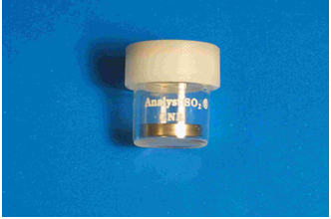
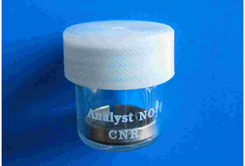
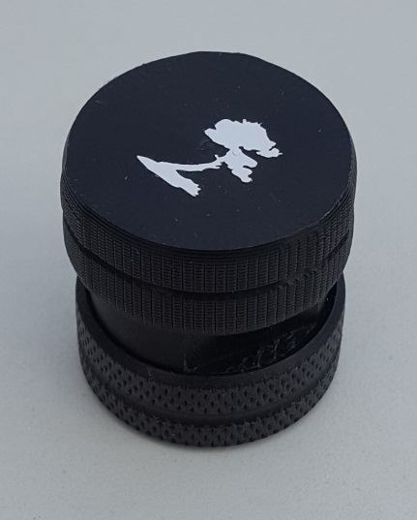
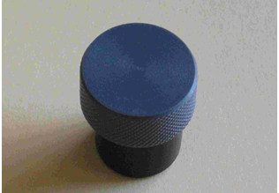
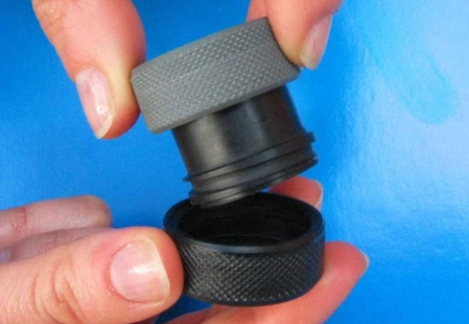
SO₂
NO₂
ANALYST®
Passive Samplers
H₂S
O₃
ANALYST® Samplers show definite features for air pollution monitoring…
….However…….

Slide 5
Limitations of Passive Samplers (Including ANALYST®)
.
They are not suitable for sequential sampling where, after a certain amount of time, it is required to stop the sampling on a passive sampler and then to start sampling on a new one for another period of time.
Passive samplers do not allow sampling for a fixed periods of time since, unless an operator remove them, they continue to sample pollutants from the air.
They cannot be controlled on changing conditions related, for instance, to meteorological situations.
They are always active. This limitation is very important since it does not allow to measure concentrations and expositions of important group of people according to their exposition to pollutants. For instance, monitoring in schools after lessons is not useful since it dilutes and confuses the data gathered during the students permanence.
In order to overcome these limitations, the
PASSIVE SAMPLER PAS06/15
automatic sampler was developed

Slide 6
Basic of PAS 06/15
1 Rotating plate with plugs
2 Fixed plate with passive samplers
3 Shock adsorbing felt
5 Precision optical position sensor
HOLES – Analyst on Sampling
PLUGS – Analyst not Sampling

Slide 7
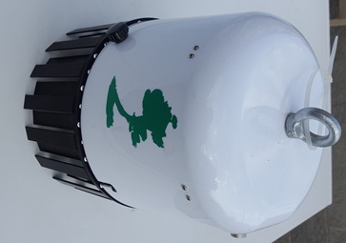
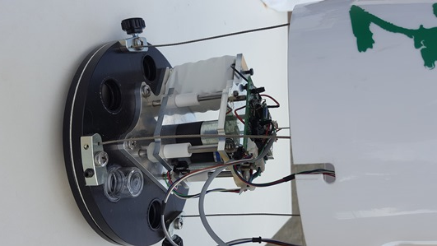
ENVINT PAS06/15
Electronics & Sensors
Cover
Battery
Motors
Anti-turbulence Shield
Fixed plate with samplers
H= 17 cm
Diam. = 20 cm
Weight = 1.5 Kg

Slide 8
Features of PAS 06/15
Automatic sequential sampling of passive samplers.
Start simultaneously the sampling in all sampling sites through date and time programming.
Automatic sampling according to accumulation on fixed time intervals.
Start or interrupt sampling in presence of pre-defined conditions (up to 3 digital inputs meaning up to 8 different conditions).
Sampling one or more passive samplers according to meteorological variables such as wind speed or wind direction.
Automatically records of environmental parameters T, RH (and P)
Monitors and collect data by several analog inputs by I²C interface
Simple connections though Wi-FI and Android OS Tablets for programing and data download

Slide 9
Applications
Sequential sampling in air quality measurement.
Air quality Monitoring in sites not served by conventional monitoring stations.
Classification of a site. Monitoring of two or three pollutant may give indication about the nature of the monitoring site (Urban industrial, background, etc.)
Space integration of air pollution data. Spatial mapping of atmospheric pollution. A number of sampling sites may give some useful representation about the occurrence of pollutants in selected sites. This is for instance the case of industries, incinerators, dumps and landfill sites, etc.)
Ozone monitoring by selecting a sample for the central part of the day and another passive sampler for the other periods of the day.
Exposure monitoring: activation of ENVINT PAS06/15 according to the presence or absence of people. This is the case for schools, working sites etc.
Sampling on events. This means that passive samplers are selected according to events which are sensed by ENVINT PAS06/15 as external logical conditions. Up to eight conditions may be programmed in combination with the basic time programming.
Sick building syndrome will be easily characterised by programming passive samplers during building use or under specific conditions (temperature, humidity, etc.)
Public transportation: the sampler can be programmed in order to discriminate exposure during effective use of the vehicles for people transportation.

Slide 10
Some Preliminary Experimental Result
Contamination Test
6 BTX Analyst exposed for one month with plugs in all holes .
Observed equivalent concentrations were below MDC (0,5 µg/m³) of Benzene
Results: Blanks are not contaminated
Hydrogen Sulphide in room with open /close window
2 Analyst samplers for Hydrogen Sulphide have been alternatively exposed from 8:00 AM to 8:00 PM and from 8:00 PM to 8:00 AM in a room with windows normally open during the day:
Results: Day time concentration: 0,6 µg/m³ Nigh time concentration: 1,6 µg/m³
Ozone in Daytime (8 h maximum)
2 Analyst samplers for Ozone have been alternatively exposed from 10:00 AM to 6:00 PM and from 6:00 PM to in open atmosphere in July 2017. Location: west of Rome
Results: (Still under check) 8h Conc: 105 µg/m³ Nigh time concentration: 45 µg/m³

Slide 11
Conclusion
PAS 06/15 is a major breakthrough in monitoring air pollution in ambient and indoor atmosphere
PAS 06/15 is giving a significant contribution to ENVINT mission:
Our mission is innovation in the monitoring of air quality
THANKS FOR YOUR ATTENTION
www.envint.it

