Slide 1

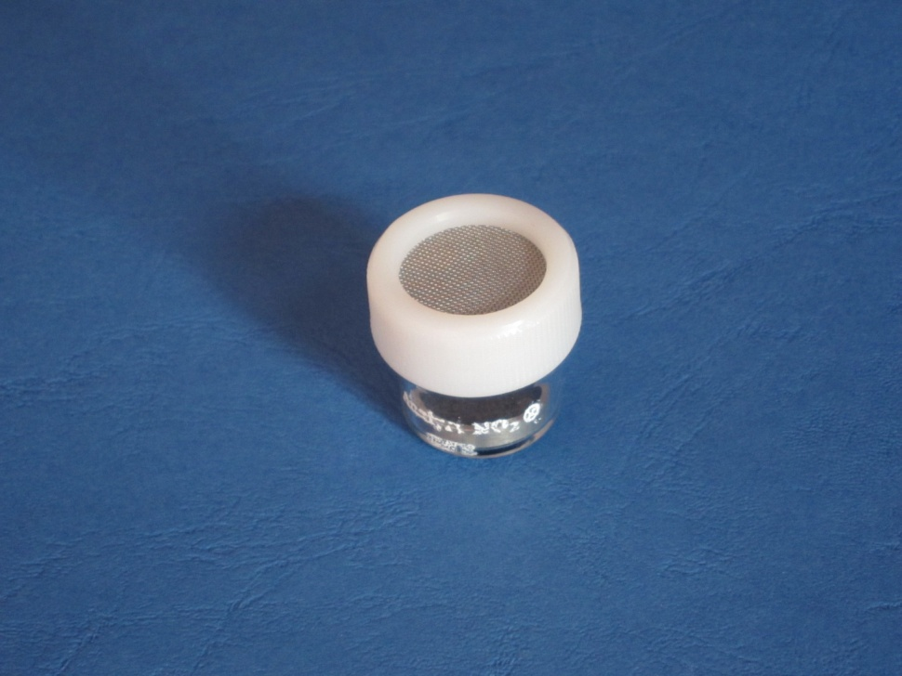
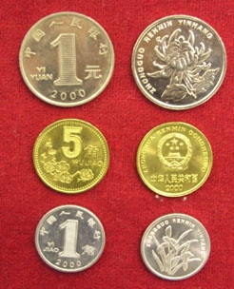

ENVINT srl
Environmental International
Consulting
PASSIVE SAMPLING
ANALYST®
A VALUE IN AIR POLLUTION MONITORING

Slide 2
PASSIVE SAMPLING IN AIR POLLUTION MONITORING
The passive samplers are:
Simple and convenient for sampling a number of atmospheric gaseous pollutants
They allow measurements with a resolution time from one week to one or two months over several sites simultaneously
They complement and replace more complex and expensive automatic monitoring stations
Features of Passive sampling:
No pumping systems
No specialized people for handling
High spatial resolution
Long-term average results
Low cost
Silent

Slide 3
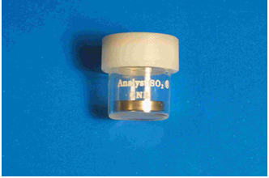
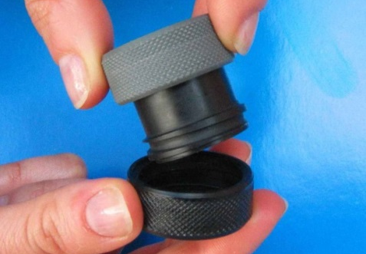
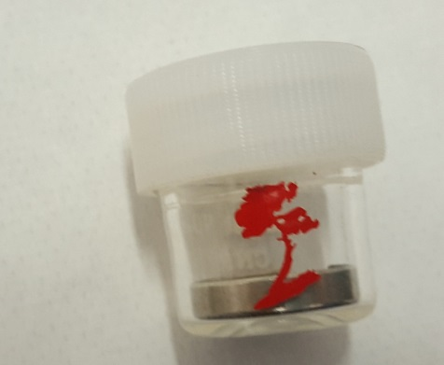
ANALYST® PASSIVE SAMPLERS ARE AVAILABLE FOR A HIGH NUMBER OF POLLUTANTS
Pollutants Detected by ANALYST® Passive Samplers
SO₂ –Sulphur Dioxide
BTEX-Benzene
NO, NOx Nitrogen Oxides
NO₂-Nitrogen Dioxide
O₃-Ozone
Mercury (Gas)
H₂S-Hydrogen Sulphide
NH₃-Ammonia
HCl, HF, HNO₃-Acids
HNO₂-Nitrous Acid
CO₂-Carbon Dioxide
VOCs-Organics
Ammines
Nicotine (3-ethenylpyridine)
PAH
Hydrazine
Formaldehyde
SO₂
H₂S
NO₂
* ANALYST is a Trademark of ENVINT srl

Slide 4
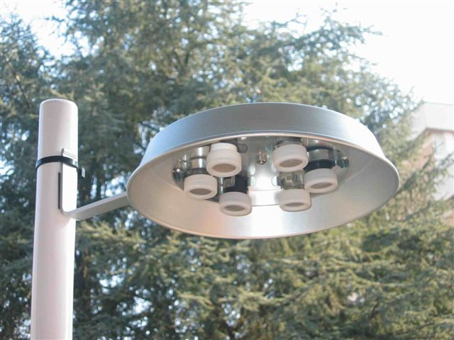
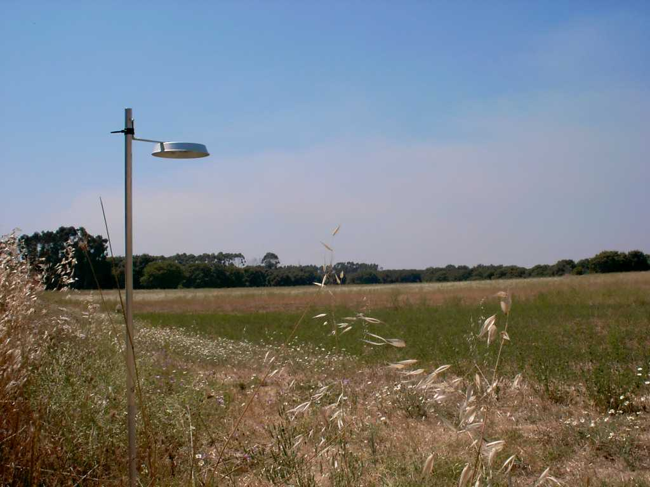
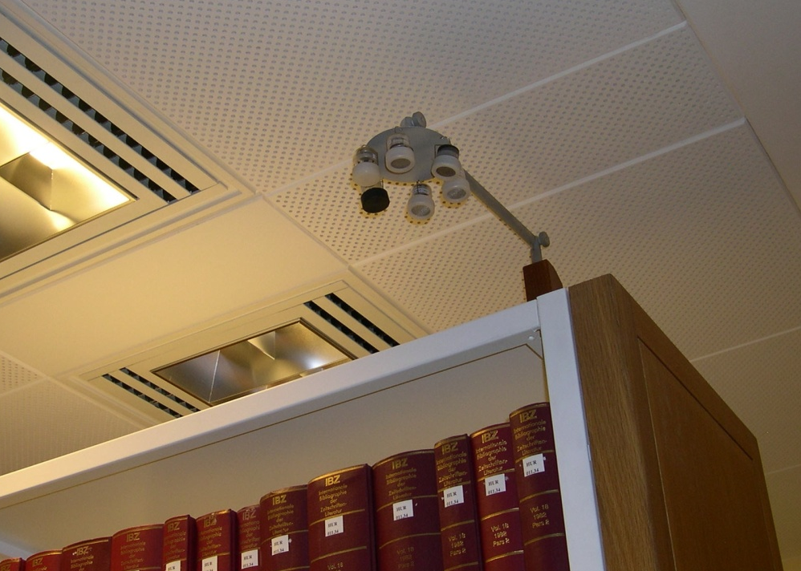
FIELD EXPOSURE IS VERY SIMPLE
……. even in indoor environments

Slide 5
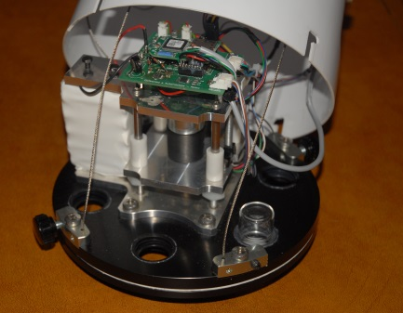
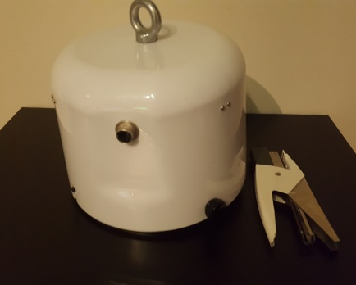

NOW AUTOMATIC SAMPLING IS POSSIBLE
BY USING THE NEW
ENVINT PAS 06/15
Automatic programmable sampling in 6 positions
Wi-Fi Connection
Allows Conditional sampling
Monitoring of temperature and relative Humnidity
Conditional sampling through difital inputs
Programmable by Android OS Tablets
Monitors external analog inputs
Low cost and no maintenance
Program 1
Wi-Fi
PAS 06/15
Electronics
TABLET
Program 2
Program 6

Slide 6



ENVINT srl
FOR A CLEANER AIR WORLDWIDE
EnvInt srl
Via Paradiso 65/A
02434 Montopoli di Sabina (RI), ITALY
Tel: +39.0765.423560 Mobile: +39.335462208
E-Mail: ivo.allegrini@tiscali.it;
Website: www.envint.it
ENVINT srl is the operative Company appointed for the Sino-Italian cooperative project on “PM 2.5 Monitoring Capability Construction Project for Beijing Municipal Environmental Monitoring Centre”

